Slide 1


CHM 103: Organic Chemistry I
Presented by:
Assoc Prof Okoli BJ MRSC, MACS
Department of Chemical Science,
Faculty of Science & Technology
Bingham University
The University with the difference
Bingham University

Slide 2
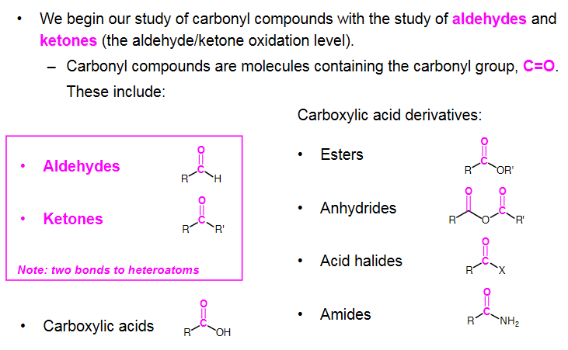

Carbonyl Chemistry
Bingham University

Slide 3
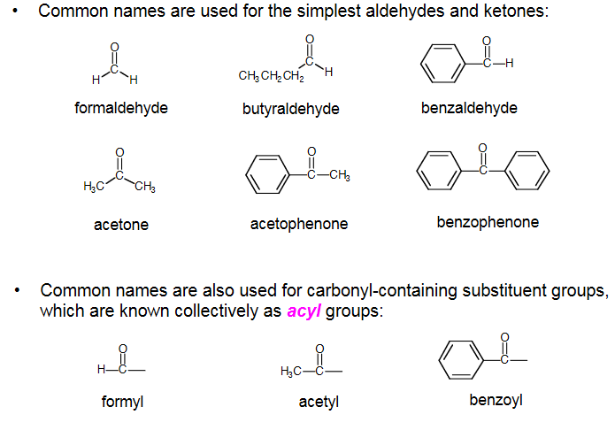
Nomenclature of Aldehydes and Ketones
Bingham University

Slide 4
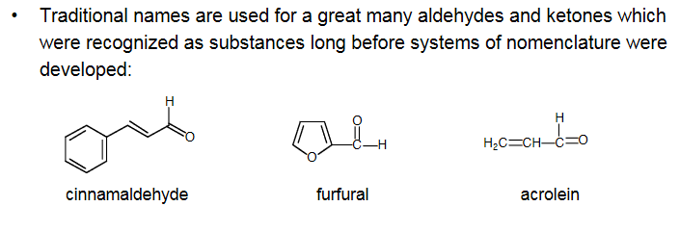
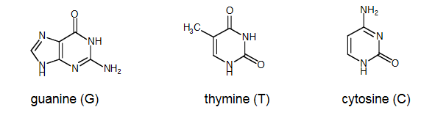
Nomenclature of Aldehydes and Ketones continue
Bingham University

Slide 5
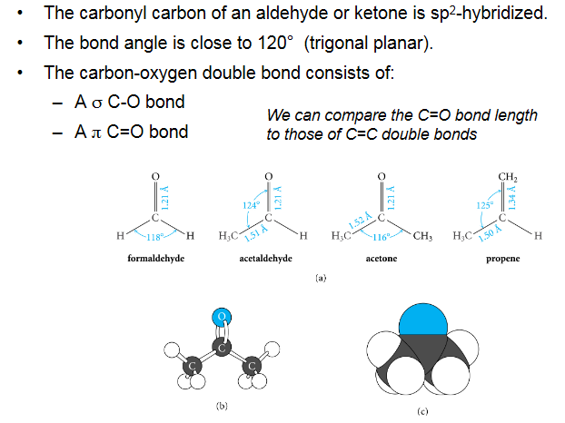
Structure of Aldehydes and Ketones
Bingham University

Slide 6
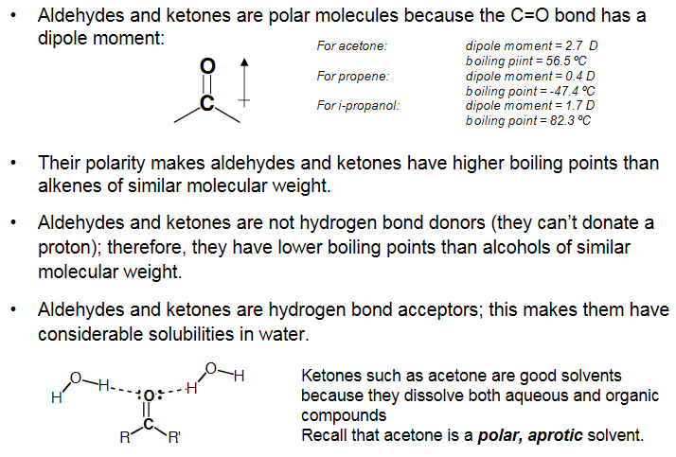
Properties of Aldehydes and Ketones
Bingham University

Slide 7
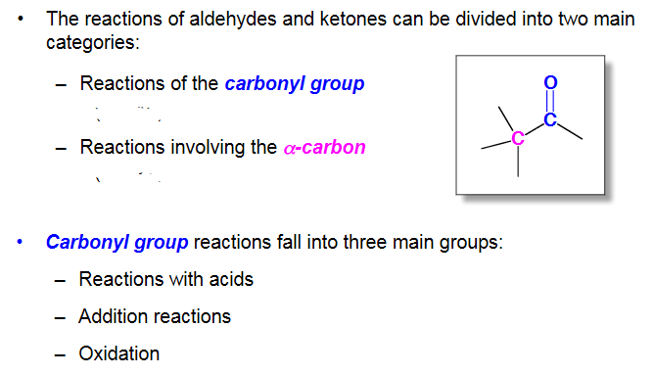
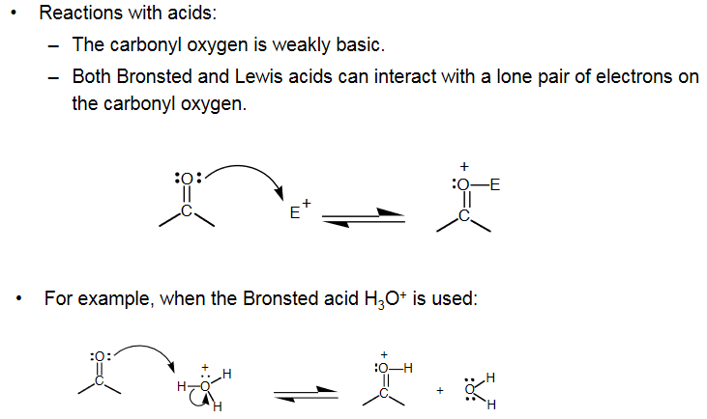
Reactions of Aldehydes and Ketones
Bingham University

Slide 8
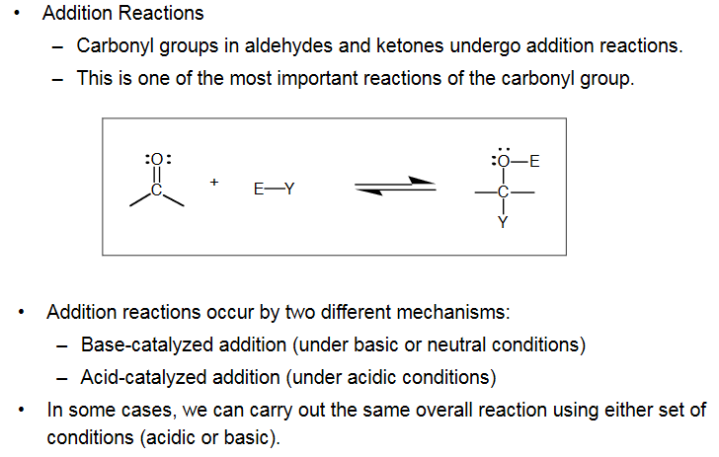
Reactions of Aldehydes and Ketones
Bingham University

Slide 9
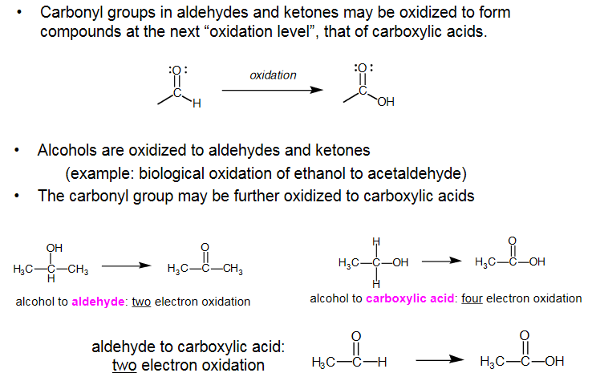
Reactions of Aldehydes and Ketones
Bingham University

Slide 10
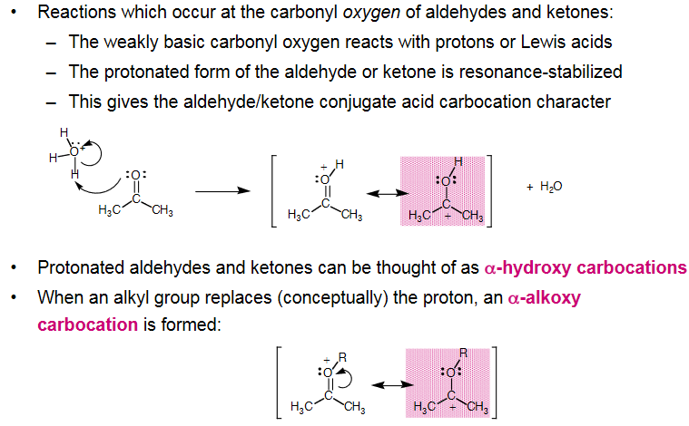
Basicity of Aldehydes and Ketones
Bingham University

Slide 11
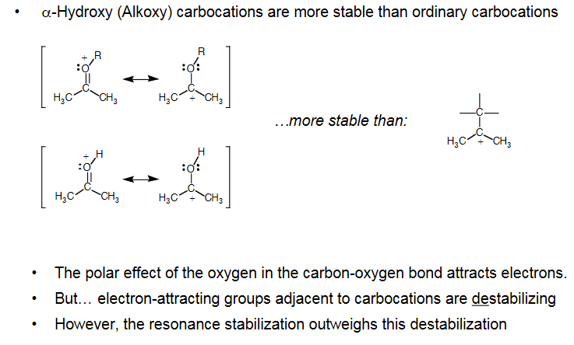
α-Hydroxy (Alkoxy) Carbocations
Bingham University

Slide 12
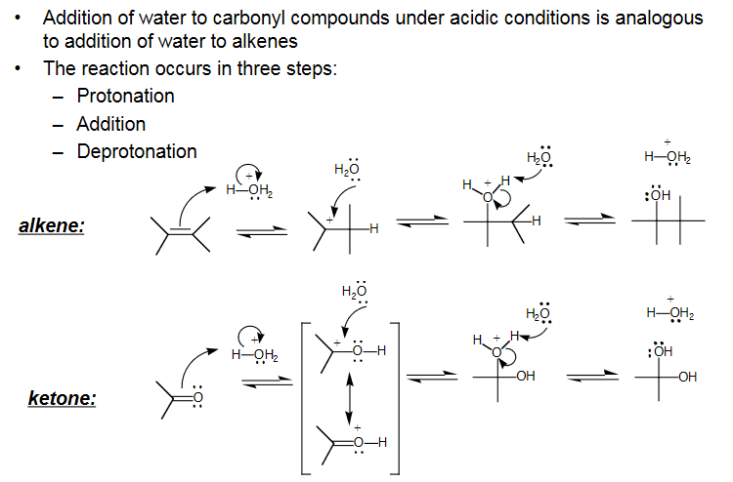
Addition Under Acidic Conditions
Bingham University

Slide 13
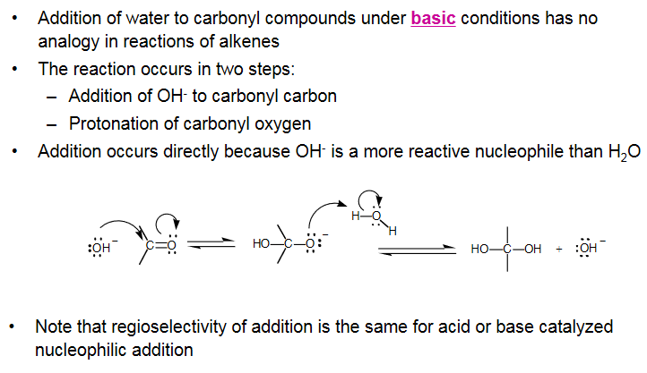
Addition Under Basic Conditions
Bingham University

Slide 14
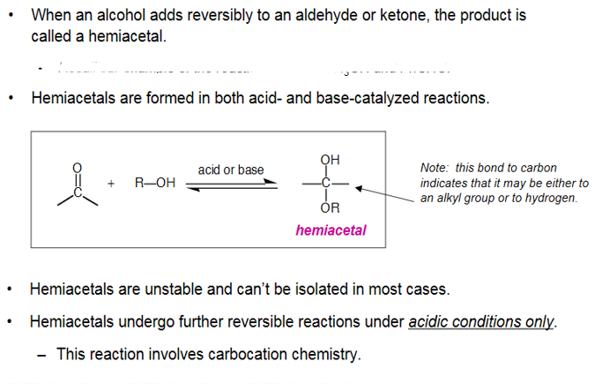
Formation of Hemiacetals and Acetals
Bingham University

Slide 15
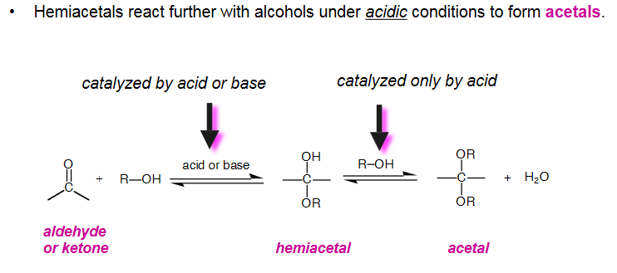
Formation of Acetals
Bingham University

Slide 16
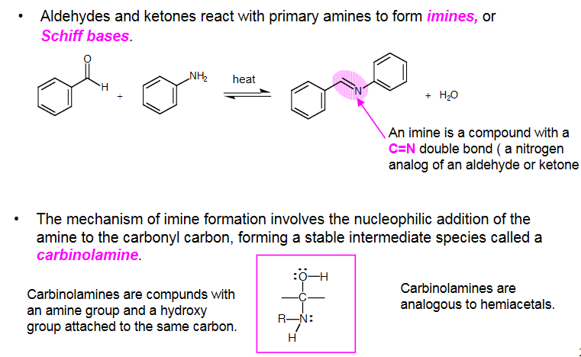
Reactions of Aldehydes and Ketones with Amines
Bingham University

Slide 17
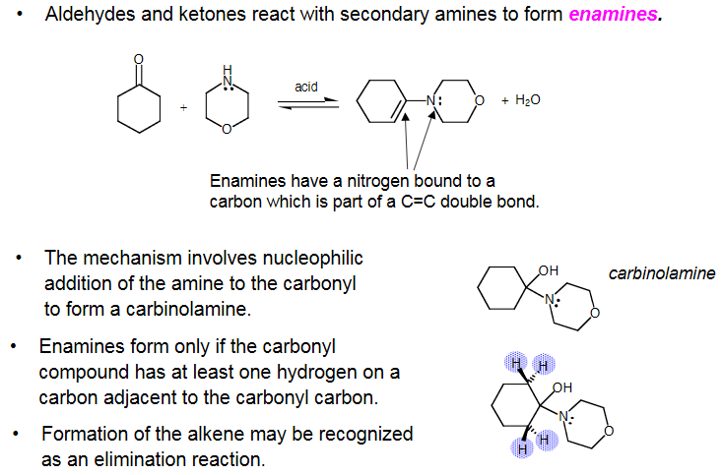
Reaction of Aldehydes/Ketones with 2°Amines
Bingham University

Slide 18
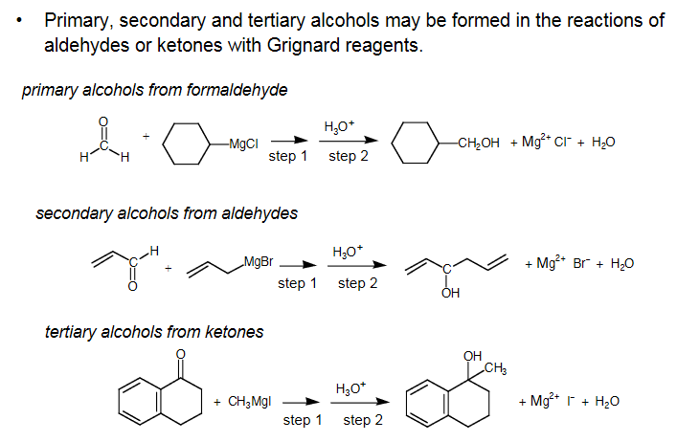
Addition Using Grignard Reagents
Bingham University

Slide 19
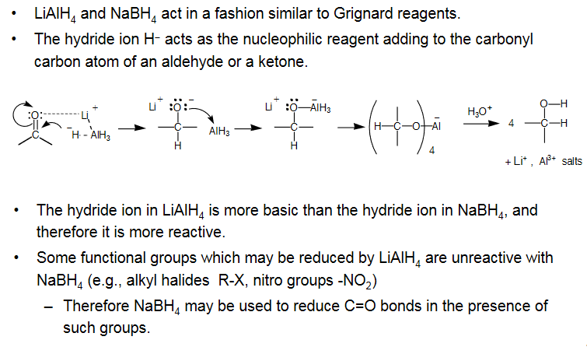
Metal Hydrides
Bingham University

Slide 20

Bingham University

Slide 21

Bingham University

